Slide 1
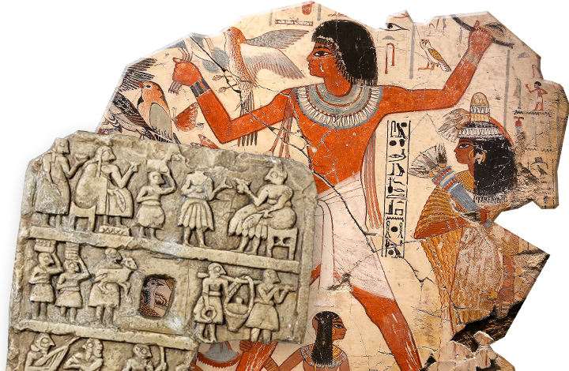
Investigating Ancient Civilisations
Goal/s:
Research ancient civilisations
Week 10 Lesson 2
Ms Barrie

Slide 2
Your task
Using the booklet provided, research Ancient Civilisations.
Your next assessment will involve you researching an Ancient Civilisation of your choosing, so use your research today to help you choose which one you will pick!
THINK ABOUT:
What interests you the most?
Which is easiest to find information about?

